Slide 1
Cooperating Intelligent Systems
Uninformed search
Chapter 3, AIMA

Slide 2
A ”problem” consists of
An initial state, θ(0)
A list of possible actions, α, for the agent
A goal test (there can be many goal states)
A path cost
One way to solve this is to search for a path
θ(0) → θ(1) → θ(2) → ... → θ(N)
such that θ(N) is a goal state.

Slide 3
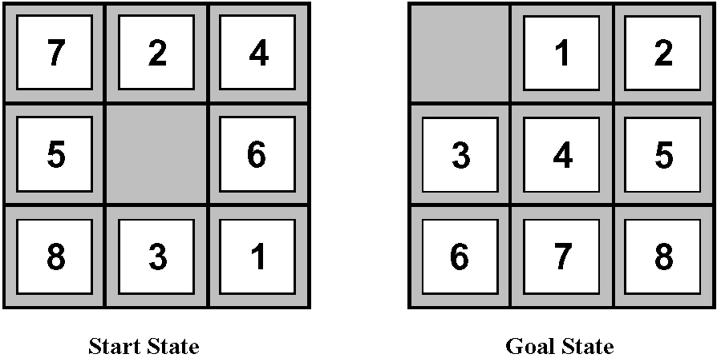
Example: 8-puzzle
State: Specification of each of the eight tiles in the nine squares (the blank is in the remaining square).
Initial state: Any state.
Successor function (actions): Blank moves Left, Right, Up, or Down.
Goal test: Check whether the goal state has been reached.
Path cost: Each move costs 1. The path cost = the number of moves.
2
8
3
1
2
3
1
6
4
8
4
7
5
7
6
5
Start State
Goal State

Slide 4
Example: 8-puzzle
State: Specification of each of the eight tiles in the nine squares (the blank is in the remaining square).
Initial state: Any state.
Successor function (actions): Blank moves Left, Right, Up, or Down.
Goal test: Check whether the goal state has been reached.
Path cost: Each move costs 1. The path cost = the number of moves.
Examples:
= {7, 2, 4, 5, 0, 6, 8, 3, 1}
= {2, 8, 3, 1, 6, 4, 7, 0, 5}
2
8
3
1
2
3
1
6
4
8
4
7
5
7
6
5
Start State
Goal State

Slide 5
Example: 8-puzzle
State: Specification of each of the eight tiles in the nine squares (the blank is in the remaining square).
Initial state: Any state.
Successor function (actions): Blank moves Left, Right, Up, or Down.
Goal test: Check whether the goal state has been reached.
Path cost: Each move costs 1. The path cost = the number of moves.
2
8
3
1
2
3
1
6
4
8
4
7
5
7
6
5
Start State
Goal State

Slide 6
Expanding 8-puzzle
2
8
3
= {2, 8, 3, 1, 6, 4, 7, 0, 5}
1
6
4
7
5
Blank moves left
Blank moves right
Blank moves up
2
8
3
2
8
3
2
8
3
1
6
4
1
4
1
6
4
7
5
7
6
5
7
5
= {2, 8, 3, 1, 6, 4, 0, 7, 5}
= {2, 8, 3, 1, 6, 4, 7, 5, 0}
= {2, 8, 3, 1, 0, 4, 7, 6, 5}

Slide 7
Uninformed search
Searching for the goal without knowing in which direction it is.
  Breadth-first
  Depth-first
  Iterative deepening
  (Depth and breadth refers to the search tree)
  We evaluate the algorithms by their:
  Completeness (do they explore all possibilities)
  Optimality (do they find the solution with minimum path cost)
  Time complexity (number of nodes expanded during search)
  Space complexity (maximum number of nodes in memory)

Slide 8
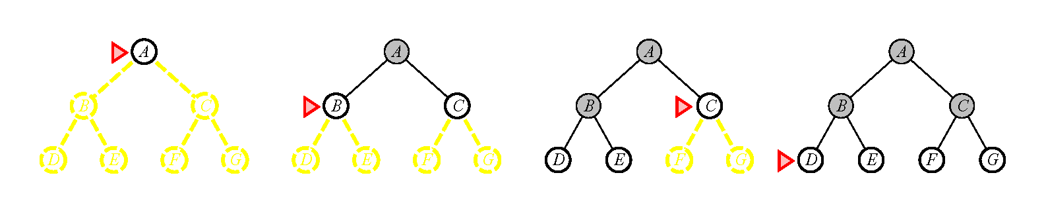
Breadth-first
Image from Russel & Norvig, AIMA, 2003
Nodes marked with open circles = fringe = in the memory
Breadth-first finds the solution that is closest (in the graph) to the start node (always expands the shallowest node).
Keeps O(b^{d}) nodes in memory → exponential memory requirement!
Complete (finds a solution if there is one)
Not necessarily optimal (optimal if cost is the same for each step)
Exponential space complexity (very bad)
Exponential time complexity
b = branching factor, d = depth

Slide 9
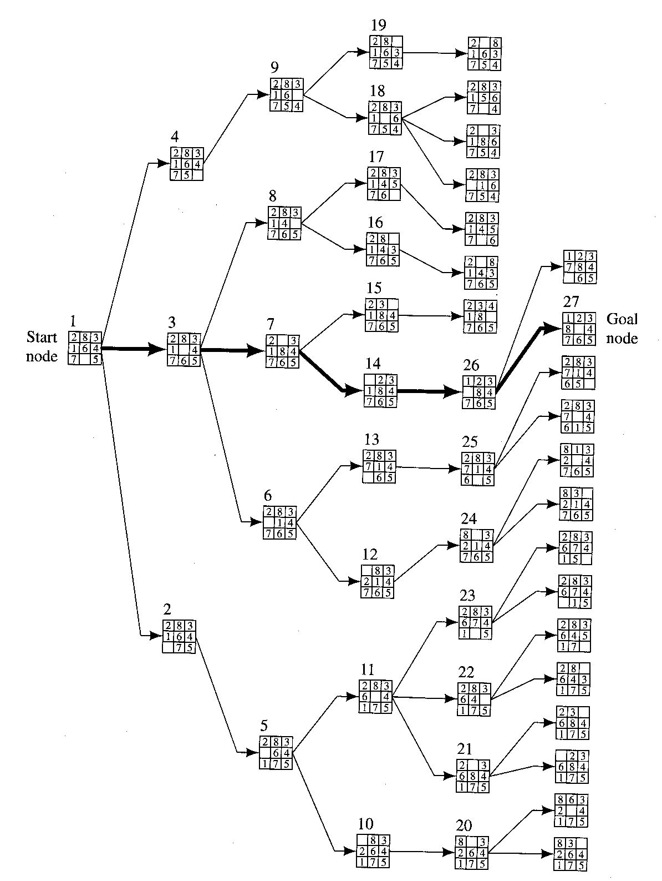
Image from N. J. Nilsson, Artificial Intelligence – A New Synthesis, 1998
Breadth-first search for 8-puzzle.
The path marked by bold arrows is the solution.
Note: This assumes that you apply goal test immediately after expansion
(not the case for AIMA implementation)
If we keep track of visited states → Graph search (rather than tree search)
Solution in node # 46

Slide 10
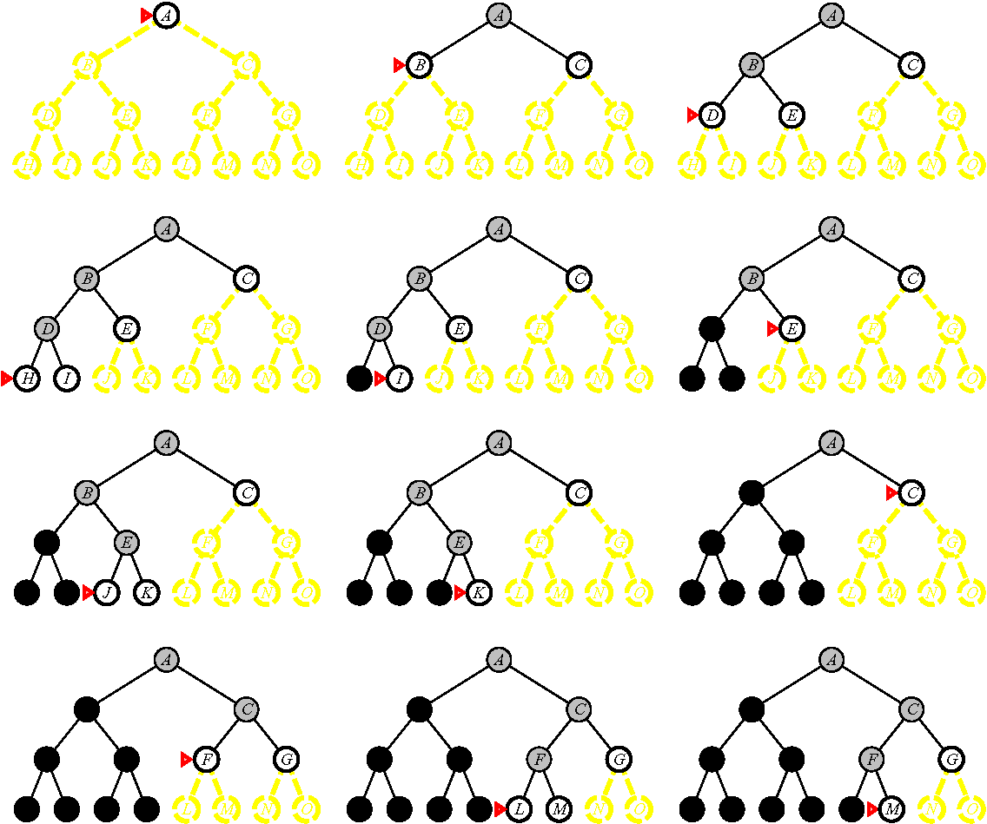
Depth-first
Image from Russel & Norvig, AIMA, 2003
Keeps O(bd) nodes in memory.
Requires a depth limit to avoid infinite paths
(limit is 3 in the figure).
Incomplete (is not guaranteed to find a solution)
Not optimal
Linear space complexity (good)
Exponential time complexity
Black nodes are removed from memory
b = branching factor, d = depth

Slide 11
Image from N. J. Nilsson, Artificial Intelligence – A New Synthesis, 1998
Depth-first on the 8-puzzle example.
Depth = 5
Solution in node # 31

Slide 12
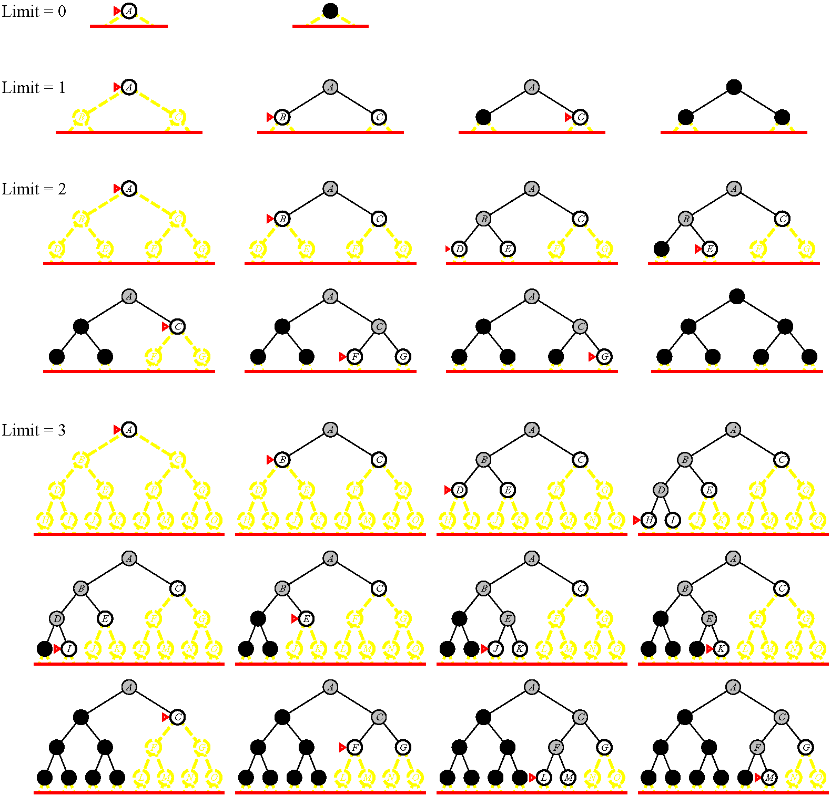
Iterative deepening
Image from Russel & Norvig, AIMA, 2003
Keeps O(bd) nodes in memory.
Iteratively increases the depth limit.
Complete (like BFS)
Not optimal
Linear space complexity
(like DFS)
Exponential time complexity
The preferred search method for large search spaces with unknown depth.
Black nodes are removed from memory
b = branching factor, d = depth

Slide 13
Exercise
Exercise 3.4: Show that the 8-puzzle states are divided into two disjoint sets, such that no state in one set can be transformed into a state in the other set by any number of moves. Devise a procedure that will tell you which class a given state is in, and explain why this is a good thing to have for generating random states.

Slide 14
Proof for exercise 3.4:
Definition: Define the order of counting from the upper left corner to the lower right corner (see figure).
Let N denote the number of lower numbers following a number (so-called ”inversions”) when counting in this fashion.
N = 11 in the figure.
2
8
3
1
6
4
7
5
2
8
3
1
6
4
7
5
2
8
3
2
8
3
2
8
3
2
8
3
2
8
3
Yellow tiles are inverted
relative to the tile with
”8” in the top row.
1
6
4
1
6
4
1
6
4
1
6
4
1
6
4
7
5
7
5
7
5
7
5
7
5
1
+
6
+
1
+
2
+
1
= 11

Slide 15
Proof for exercise 3.4:
Proposition: N is either always even or odd
(i.e. Nmod2 is conserved).
Proof:
(1) Sliding the blank along a row does not change the row number and not the internal order of the tiles, i.e. N (and thus also Nmod2) is conserved.
(2) Sliding the blank between rows does not change Nmod2 either, as shown on the following slide.

Slide 16
Proof for exercise 3.4:
We only need to consider tiles B, C, and D since the relative order of the other tiles remains the same.
If B > C and B > D, then the move removes two inversions.
If B > C and B < D, then the move adds one inversion and removes one (sum = 0).
If B < C and B < D, then the move adds two inversions.
The number of inversions changes in steps of 2.
A
B
C
D
E
F
G
H
A
C
D
B
E
F
G
H

Slide 17
Observation
The upper state has N = 0
The lower (goal) state has N = 7
We cannot go from one to the other.
1
2
3
4
5
6
7
8
1
2
3
8
4
7
6
5

Slide 18
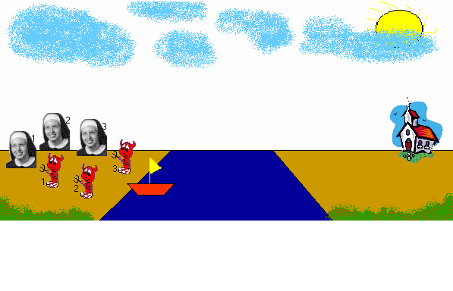
Exercise
Exercise 3.9: The missionaries and cannibals: Three missionaries and three cannibals are on one side of a river, along with a boat that can hold one or two people (one for rowing). Find a way to get everyone to the other side, without ever leaving a group of missionaries in one place outnumbered by the cannibals in that place (the cannibals eat the missionaries then).
Formulate the problem precisely, making only those distinctions necessary to ensure a valid solution. Draw a diagram of the complete state space.
Implement and solve the problem optimally using an appropriate search algorithm. Is it a good idea to check for repeated states?
Why do you think people have a hard time solving this puzzle, given that the state space is so simple?
Image from http://www.cse.msu.edu/~michmer3/440/Lab1/cannibal.html

Slide 19
Missionaries & Cannibals
State: θ = (M,C,B) signifying the number of missionaries, cannibals, and boats on the left bank. The start state is (3,3,1) and the goal state is (0,0,0).
Actions (successor function): (10 possible but only 5 available each move due to boat)
One cannibal/missionary crossing L → R: subtract (0,1,1) or (1,0,1)
Two cannibals/missionaries crossing L → R: subtract (0,2,1) or (2,0,1)
One cannibal/missionary crossing R → L: add (1,0,1) or (0,1,1)
Two cannibals/missionaries crossing R → L: add (2,0,1) or (0,2,1)
One cannibal and one missionary crossing: add/subtract (1,1,1)
Image from http://www.cse.msu.edu/~michmer3/440/Lab1/cannibal.html

Slide 20
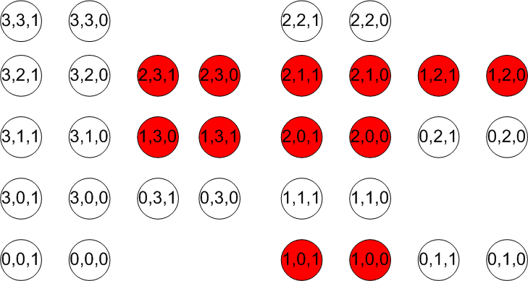
Missionaries & Cannibals states
Assumes that passengers have to get out of the boat after the trip.
Red states = missionaries get eaten.

Slide 21

Breadth-first search on
Missionaries & Cannibals
States are generated by applying:
+/- (1,0,1)
+/- (0,1,1)
+/- (2,0,1)
+/- (0,2,1)
+/- (1,1,1)
In that order (left to right)
Red states = missionaries get eaten
Yellow states = repeated states

Slide 22
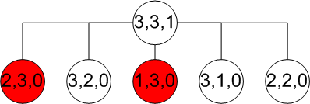
Breadth-first search on
Missionaries & Cannibals
States are generated by applying:
+/- (1,0,1)
+/- (0,1,1)
+/- (2,0,1)
+/- (0,2,1)
+/- (1,1,1)
In that order (left to right)
Red states = missionaries get eaten
Yellow states = repeated states

Slide 23
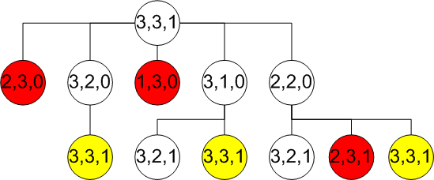
Breadth-first search on
Missionaries & Cannibals
States are generated by applying:
+/- (1,0,1)
+/- (0,1,1)
+/- (2,0,1)
+/- (0,2,1)
+/- (1,1,1)
In that order (left to right)
Red states = missionaries get eaten
Yellow states = repeated states

Slide 24
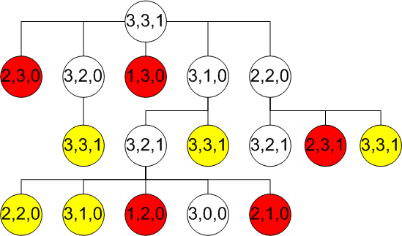
Breadth-first search on
Missionaries & Cannibals
States are generated by applying:
+/- (1,0,1)
+/- (0,1,1)
+/- (2,0,1)
+/- (0,2,1)
+/- (1,1,1)
In that order (left to right)
Red states = missionaries get eaten
Yellow states = repeated states
❒

Slide 25
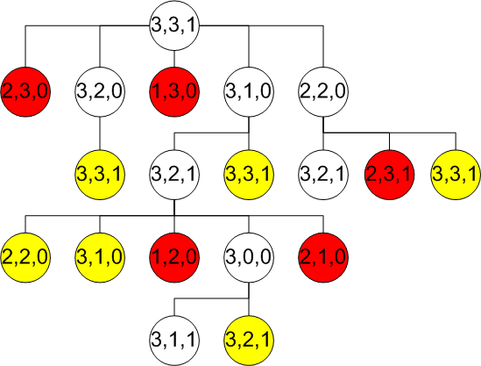
Breadth-first search on
Missionaries & Cannibals
States are generated by applying:
+/- (1,0,1)
+/- (0,1,1)
+/- (2,0,1)
+/- (0,2,1)
+/- (1,1,1)
In that order (left to right)
Red states = missionaries get eaten
Yellow states = repeated states
❒

Slide 26
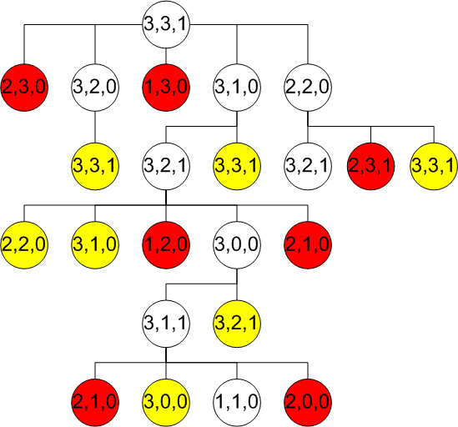
Breadth-first search on
Missionaries & Cannibals
States are generated by applying:
+/- (1,0,1)
+/- (0,1,1)
+/- (2,0,1)
+/- (0,2,1)
+/- (1,1,1)
In that order (left to right)
Red states = missionaries get eaten
Yellow states = repeated states
❒

Slide 27
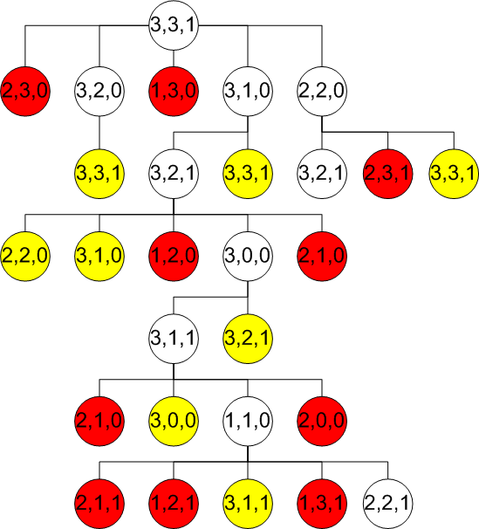
Breadth-first search on
Missionaries & Cannibals
States are generated by applying:
+/- (1,0,1)
+/- (0,1,1)
+/- (2,0,1)
+/- (0,2,1)
+/- (1,1,1)
In that order (left to right)
Red states = missionaries get eaten
Yellow states = repeated states
❒

Slide 28
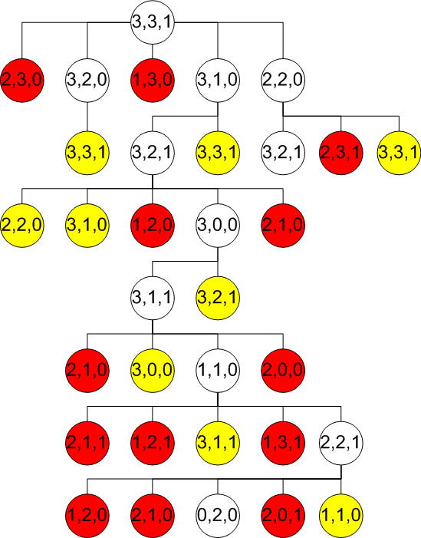
Breadth-first search on
Missionaries & Cannibals
States are generated by applying:
+/- (1,0,1)
+/- (0,1,1)
+/- (2,0,1)
+/- (0,2,1)
+/- (1,1,1)
In that order (left to right)
Red states = missionaries get eaten
Yellow states = repeated states
❒

Slide 29
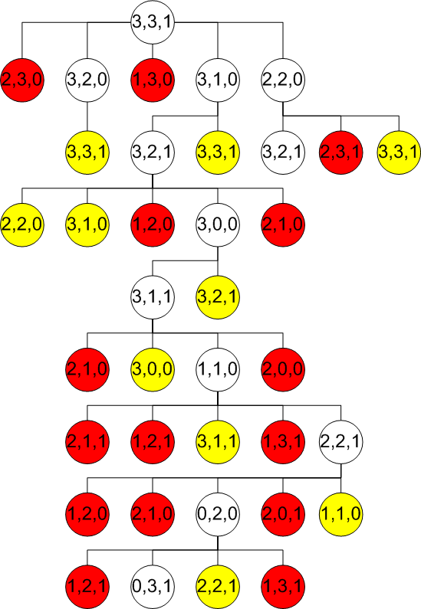
Breadth-first search on
Missionaries & Cannibals
States are generated by applying:
+/- (1,0,1)
+/- (0,1,1)
+/- (2,0,1)
+/- (0,2,1)
+/- (1,1,1)
In that order (left to right)
Red states = missionaries get eaten
Yellow states = repeated states
❒

Slide 30
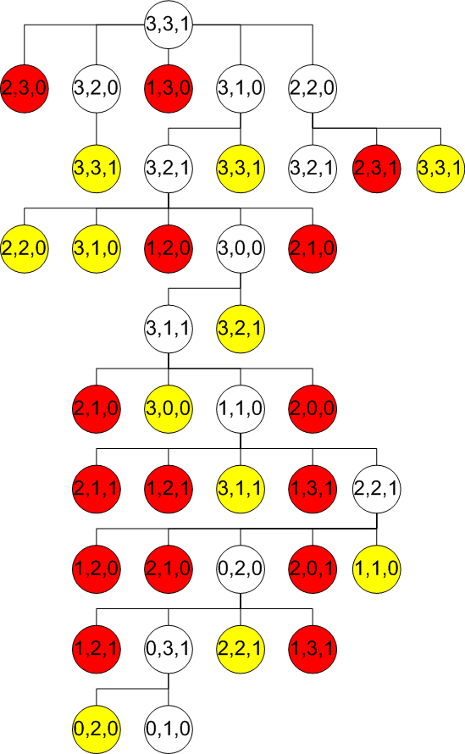
Breadth-first search on
Missionaries & Cannibals
States are generated by applying:
+/- (1,0,1)
+/- (0,1,1)
+/- (2,0,1)
+/- (0,2,1)
+/- (1,1,1)
In that order (left to right)
Red states = missionaries get eaten
Yellow states = repeated states
❒

Slide 31
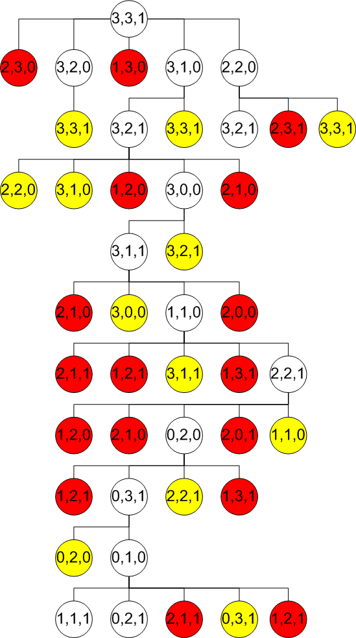
Breadth-first search on
Missionaries & Cannibals
States are generated by applying:
+/- (1,0,1)
+/- (0,1,1)
+/- (2,0,1)
+/- (0,2,1)
+/- (1,1,1)
In that order (left to right)
Red states = missionaries get eaten
Yellow states = repeated states
❒

Slide 32
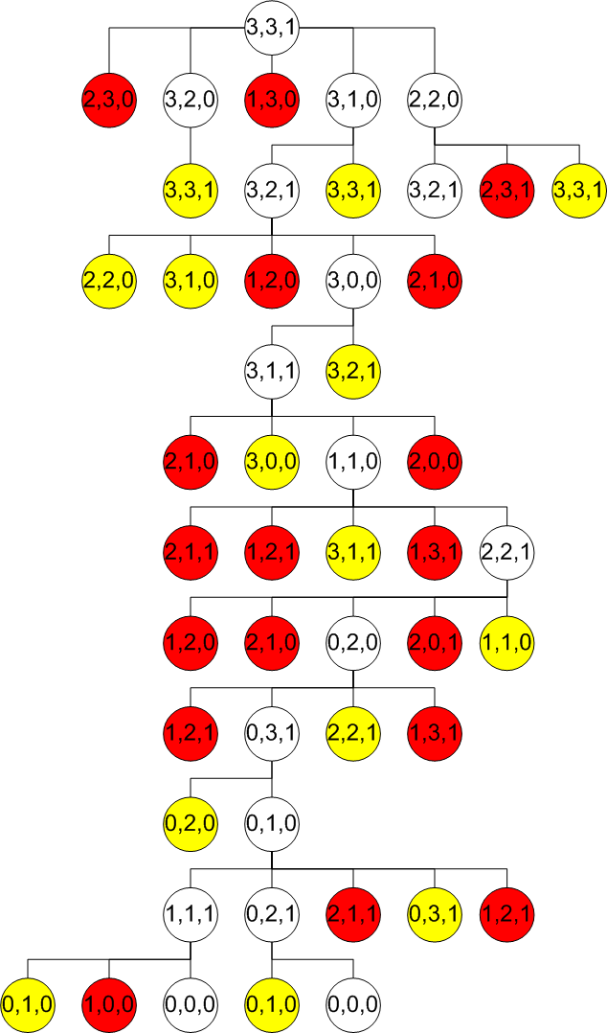
Breadth-first search on
Missionaries & Cannibals
States are generated by applying:
+/- (1,0,1)
+/- (0,1,1)
+/- (2,0,1)
+/- (0,2,1)
+/- (1,1,1)
In that order (left to right)
Red states = missionaries get eaten
Yellow states = repeated states
❒

Slide 33
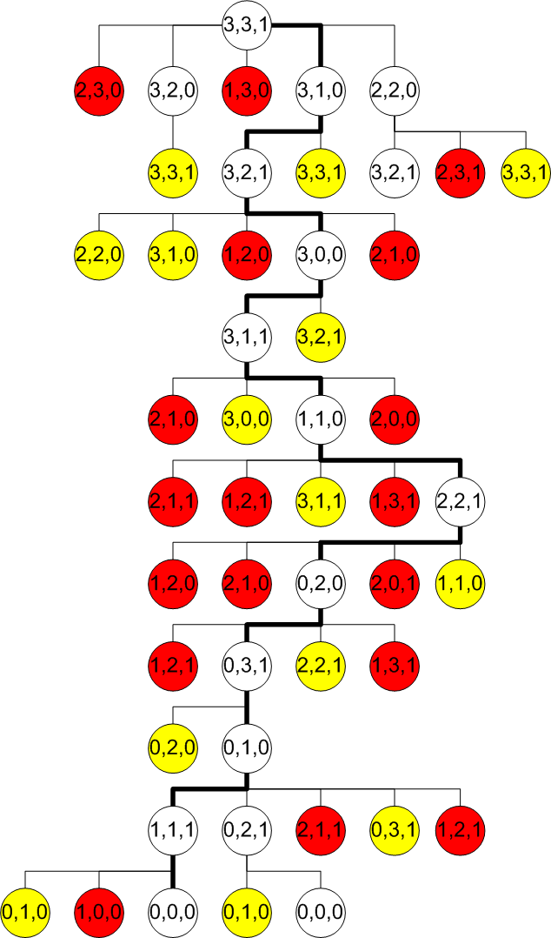
Breadth-first search on
Missionaries & Cannibals
-(0,2,1) [2 cannibals cross L → R]
+(0,1,1) [1 cannibal crosses R → L]
-(0,2,1) [2 cannibals cross L → R]
+(0,1,1) [1 cannibal crosses R → L]
-(2,0,1) [2 missionaries cross L → R]
+(1,1,1) [1 cannibal & 1 missionary cross R → L]
-(2,0,1) [2 missionaries cross L → R]
+(0,1,1) [1 cannibal crosses R → L]
-(0,2,1) [2 cannibals cross L → R]
+(1,0,1) [1 missionary crosses R → L]
-(1,1,1) [1 cannibal & 1 missionary
cross L → R]
This is an optimal solution (minimum number of crossings). [Why?]
Would Depth-first work?
❒

Slide 34
Breadth-first search on
Missionaries & Cannibals
-(0,2,1) [2 cannibals cross L → R]
+(0,1,1) [1 cannibal crosses R → L]
-(0,2,1) [2 cannibals cross L → R]
+(0,1,1) [1 cannibal crosses R → L]
-(2,0,1) [2 missionaries cross L → R]
+(1,1,1) [1 cannibal & 1 missionary cross R → L]
-(2,0,1) [2 missionaries cross L → R]
+(0,1,1) [1 cannibal crosses R → L]
-(0,2,1) [2 cannibals cross L → R]
+(1,0,1) [1 missionary crosses R → L]
-(1,1,1) [1 cannibal & 1 missionary
cross L → R]
This is an optimal solution (minimum number of crossings).
Would Depth-first work?
❒

Slide 35
Breadth-first search on
Missionaries & Cannibals
Expanded 48 nodes
Depth-first search on Missionaries & Cannibals
Expanded 30 nodes
(if repeated states are checked, otherwise we end up in an endless loop)
❒

